Slide 1


Slide 2

13
MONOPOLY
Notes:
Notes and teaching tips: 7, 16, 34, 46, 53, 54, 66, 67, and 68.
To view a full-screen figure during a class, click the expand button.
To return to the previous slide, click the shrink button.
To advance to the next slide, click anywhere on the full screen figure.
Applying the principles of economics to interpret and understand the news is a major goal of the principles course. You can encourage your students in this activity by using the two features: Economics in the News and Economics in Action.
(1) Before each class, scan the news and select two or three headlines that are relevant to your session today. There is always something that works. Read the headline and ask for comments, interpretation, discussion. Pose questions arising from it that motivate today’s class. At the end of the class, return to the questions and answer them with the tools you’ve been explaining.
(2) Once or twice a semester, set an assignment, for credit, with the following instructions:
(a) Find a news article about an economic topic that you find interesting.
(b) Make a short bullet-list summary of the article.
(c) Write and illustrate with appropriate graphs an economic analysis of the key points in the article.
Use the Economics in the News features in your textbook as models.

Slide 3
After studying this chapter, you will be able to:
Explain how monopoly arises
Explain how a single-price monopoly determines its output and price
Compare the performance and efficiency of single-price monopoly and competition
Explain how price discrimination increases profit
Explain how monopoly regulation influences output, price, economic profit, and efficiency

Slide 4
Monopoly and How It Arises
A monopoly is a market:
That produces a good or service for which no close substitute exists
In which there is one supplier that is protected from competition by a barrier preventing the entry of new firms.

Slide 5
Monopoly and How It Arises
How Monopoly Arises
A monopoly has two key features:
No close substitute
Barriers to entry
No Close Substitutes
If a good has a close substitute, even if it is produced by only one firm, that firm effectively faces competition from the producers of the substitute.
A monopoly sells a good that has no close substitutes.

Slide 6
Monopoly and How It Arises
Barriers to Entry
A constraint that protects a firm from potential competitors is called a barrier to entry.
Three types of barriers to entry are
Natural
Ownership
Legal

Slide 7
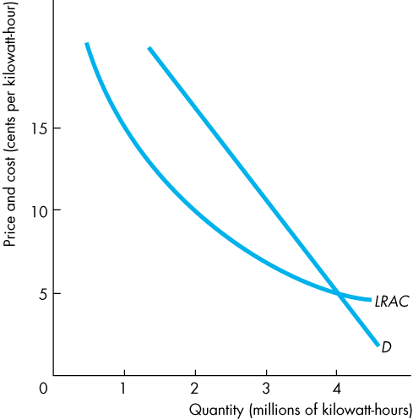

Monopoly and How It Arises
Natural Barriers to Entry
Natural barriers to entry create natural monopoly.
A natural monopoly is a market in which economies of scale enable one firm to supply the entire market at the lowest possible cost.
Figure 13.1 illustrates a natural monopoly.
Notes:
Classroom activity
Check out Economics in Action: Two Information-Age Monopolies

Slide 8
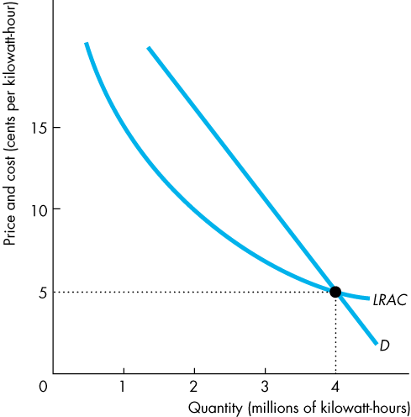
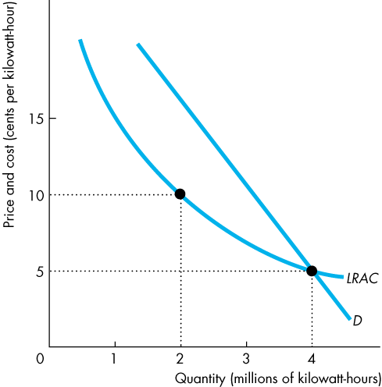

Slide 9
Monopoly and How It Arises
One firm can produce 4 million units of output at 5 cents per unit.
Two firms can produce 4 million units—2 units each—at 10 cents per unit.

Slide 10
Monopoly and How It Arises
In a natural monopoly, economies of scale are so powerful that they are still being achieved even when the entire market demand is met.
The LRAC curve is still sloping downward when it meets the demand curve.

Slide 11
Monopoly and How It Arises
Ownership Barriers to Entry
An ownership barrier to entry occurs if one firm owns a significant portion of a key resource.
During the last century, De Beers owned 90 percent of the world’s diamonds.

Slide 12
Monopoly and How It Arises
Legal Barriers to Entry
Legal barriers to entry create a legal monopoly.
A legal monopoly is a market in which competition and entry are restricted by the granting of a:
Public franchise (like the U.S. Postal Service, a public franchise to deliver first-class mail)
Government license (like a license to practice law or medicine)
Patent or copyright

Slide 13
Monopoly and How It Arises
Monopoly Price-Setting Strategies
For a monopoly firm to determine the quantity it sells, it must choose the appropriate price.
There are two types of monopoly price-setting strategies:
A single-price monopoly is a firm that must sell each unit of its output for the same price to all its customers.
Price discrimination is the practice of selling different units of a good or service for different prices. Many firms price discriminate, but not all of them are monopoly firms.

Slide 14
A Single-Price Monopoly’s Output and Price Decision
Price and Marginal Revenue
A monopoly is a price setter, not a price taker like a firm in perfect competition.
The reason is that the demand for the monopoly’s output is the market demand.
To sell a larger output, a monopoly must set a lower price.

Slide 15
A Single-Price Monopoly’s Output and Price Decision
Total revenue, TR, is the price, P, multiplied by the quantity sold, Q.
Marginal revenue, MR, is the change in total revenue that results from a one-unit increase in the quantity sold.
For a single-price monopoly, marginal revenue is less than price at each level of output. That is,
MR < P.

Slide 16
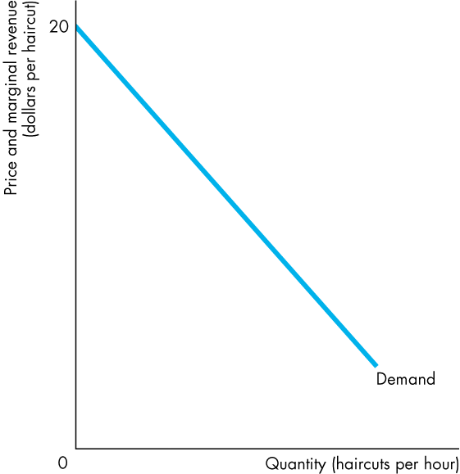
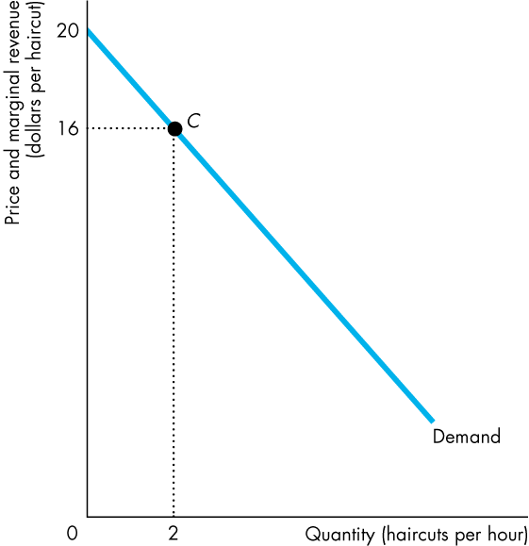
A Single-Price Monopoly’s Output and Price Decision
Figure 13.2 illustrates the relationship between the price and marginal revenue and derives the marginal revenue curve.
Suppose the monopoly sets a price of $16 and sells 2 units.
Notes:
Marginal revenue curve
Students don’t find the concept of marginal revenue difficult, but they do need to be clear on the intuition of the MR curve and the reason why MR < P for a single-price monopoly. This fact is the central source of the monopoly predictions.

Slide 17
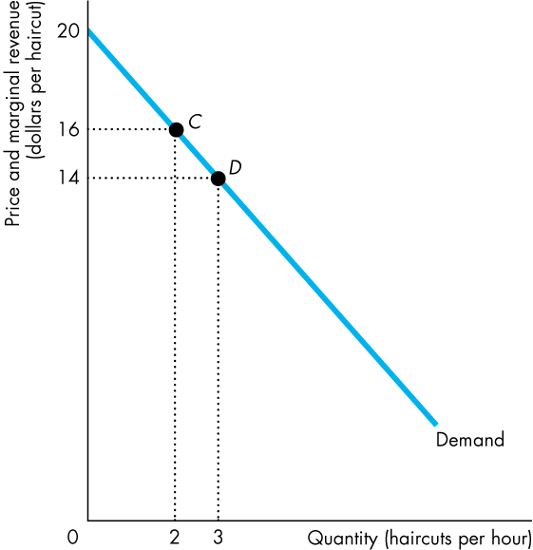
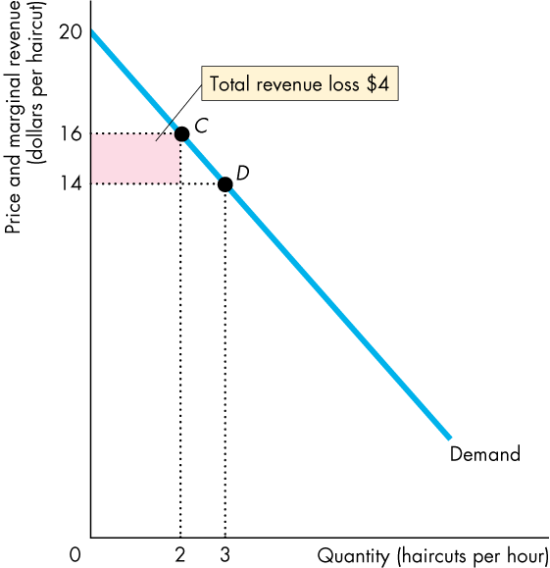
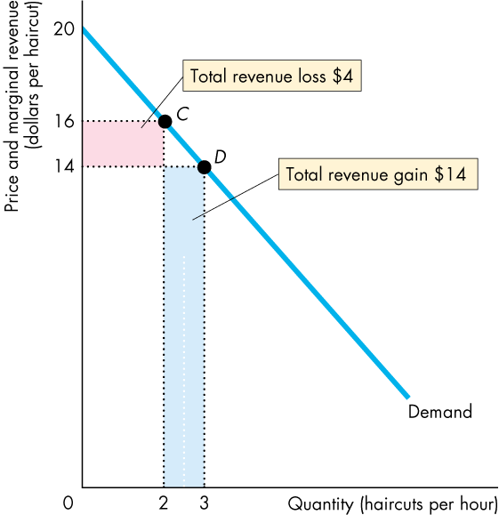
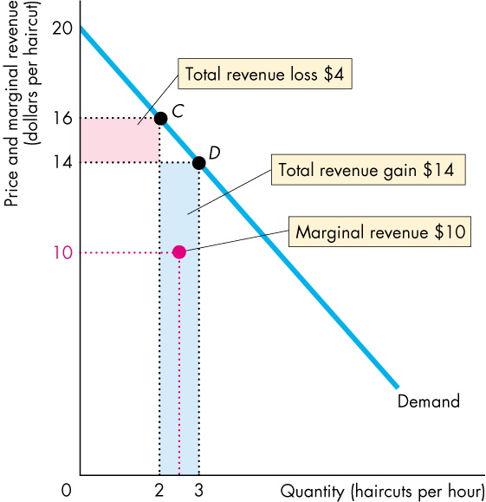
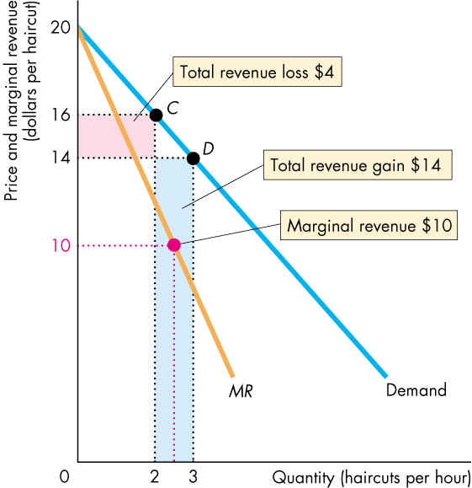

Slide 18
A Single-Price Monopoly’s Output and Price Decision
Now suppose the firm cuts the price to $14 to sell 3 units.
It loses $4 of total revenue on the 2 units it was selling at $16 each.
And it gains $14 of total revenue on the 3rd unit.
So total revenue increases by $10, which is marginal revenue.

Slide 19
A Single-Price Monopoly’s Output and Price Decision
The marginal revenue curve, MR, passes through the red dot midway between 2 and 3 units and at $10.
For a monopoly, MR < P at each quantity.

Slide 20
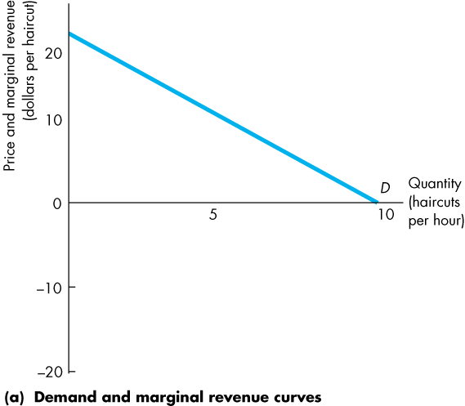
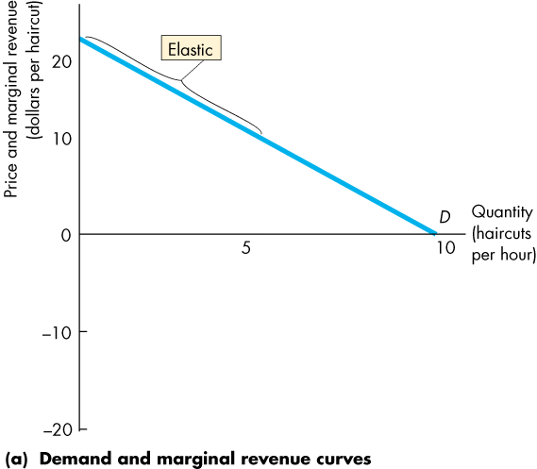
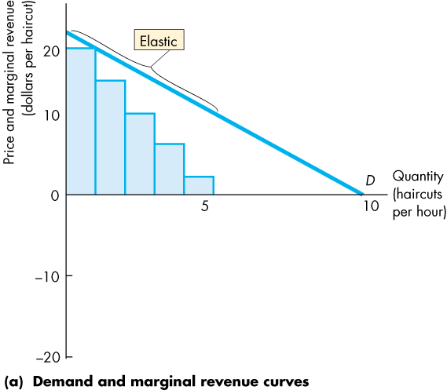
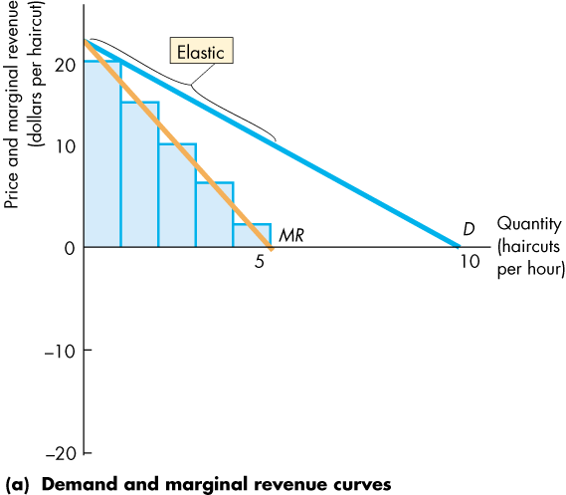
A Single-Price Monopoly’s Output and Price Decision
Marginal Revenue and Elasticity
A single-price monopoly’s marginal revenue is related to the elasticity of demand for the good.
If demand is elastic, a fall in the price brings an increase in total revenue.
MR is positive.

Slide 22
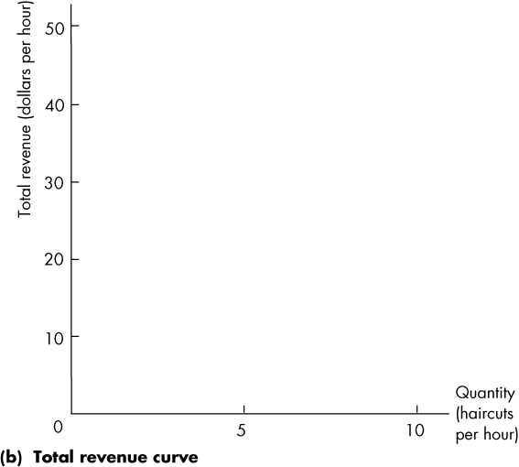
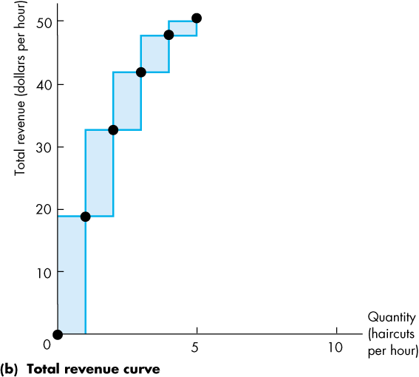
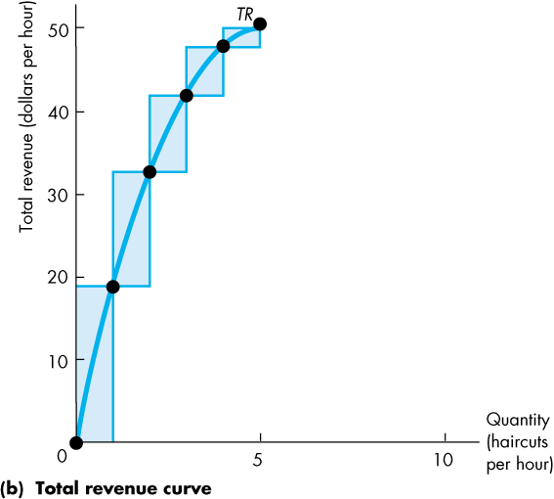
A Single-Price Monopoly’s Output and Price Decision
The increase in revenue from the greater quantity sold outweighs the decrease in revenue from the lower price per unit.
So MR is positive.
As the price falls, total revenue increases.

Slide 24
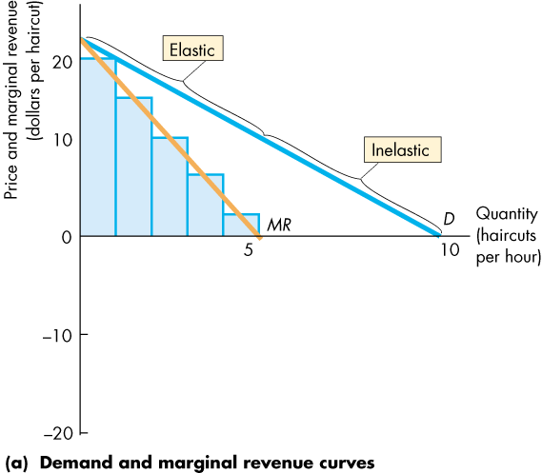
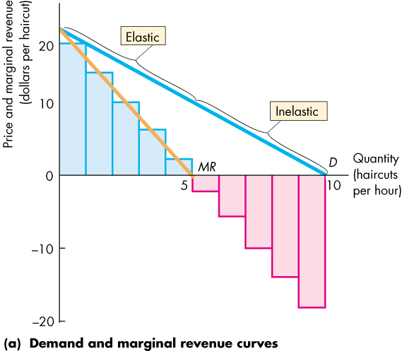
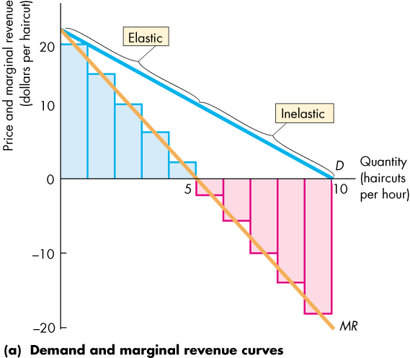
A Single-Price Monopoly’s Output and Price Decision
If demand is inelastic, a fall in the price brings a decrease in total revenue.
The rise in revenue from the increase in quantity sold is outweighed by the fall in revenue from the lower price per unit.
So MR is negative.

Slide 26
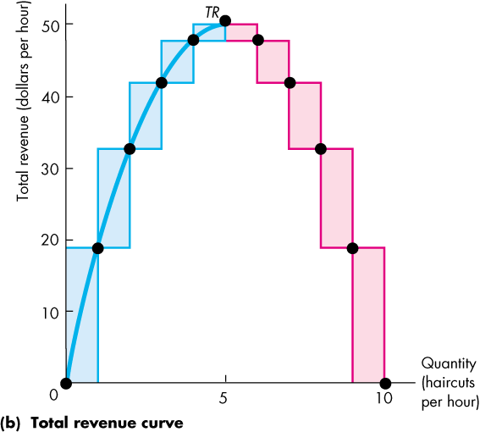
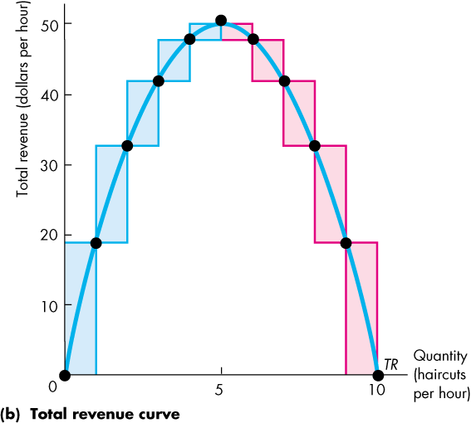
A Single-Price Monopoly’s Output and Price Decision
As the price falls, total revenue decreases.

Slide 28
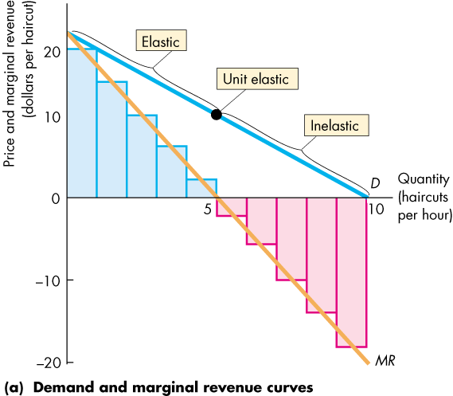
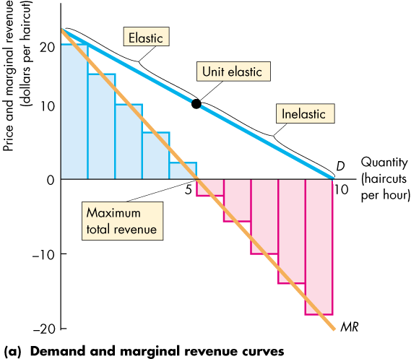
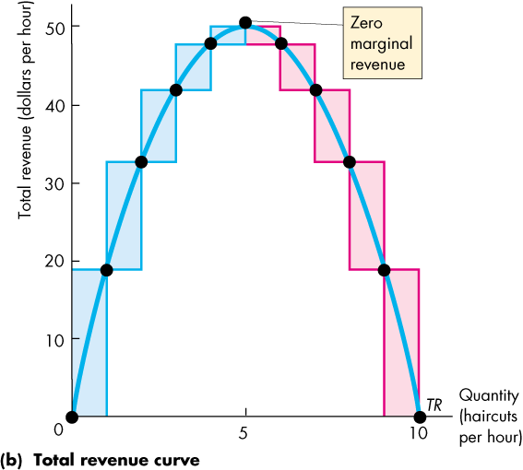
A Single-Price Monopoly’s Output and Price Decision
If demand is unit elastic, a fall in the price does not change total revenue.
The rise in revenue from the greater quantity sold equals the fall in revenue from the lower price per unit.
MR = 0.
Total revenue is maximized when MR = 0.

Slide 30
A Single-Price Monopoly’s Output and Price Decision
In Monopoly, Demand Is Always Elastic
A single-price monopoly never produces an output at which demand is inelastic.
If it did produce such an output, the firm could increase total revenue, decrease total cost, and increase economic profit by decreasing output.

Slide 31
A Single-Price Monopoly’s Output and Price Decision
Price and Output Decision
The monopoly faces the same types of technology constraints as the competitive firm, but the monopoly faces a different market constraint.
The monopoly produces the profit-maximizing quantity, where MR = MC.
The monopoly sets its price at the highest level at which it can sell the profit-maximizing quantity.

Slide 32
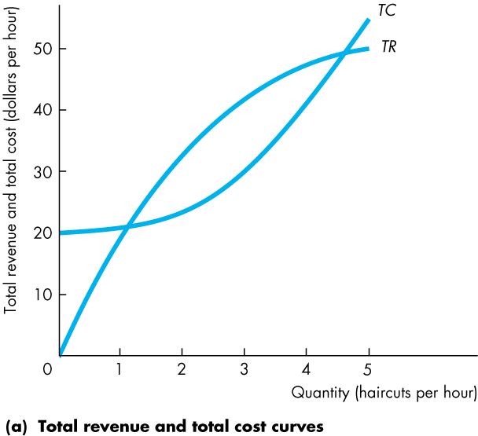
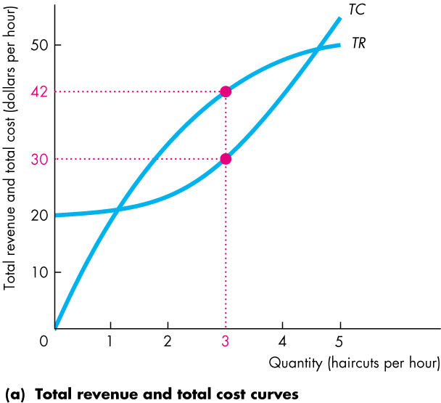
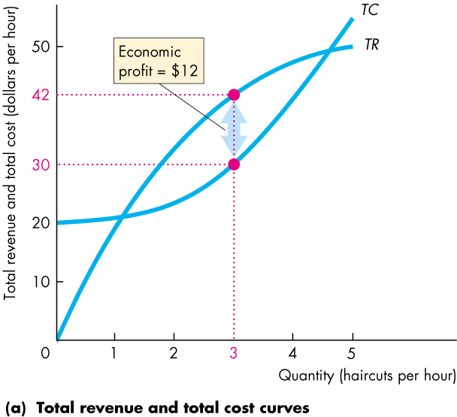
A Single-Price Monopoly’s Output and Price Decision
Figure 13.4 illustrates the profit-maximizing choices of a single-price monopoly.
In part (a), the monopoly produces the quantity that maximizes total revenue minus total cost.

Slide 34
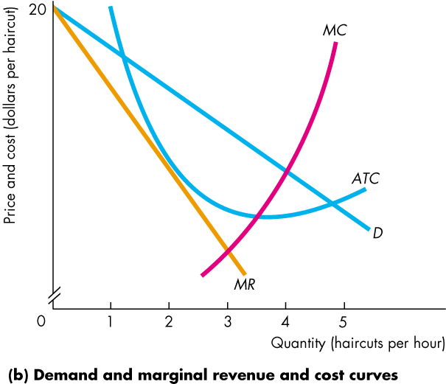
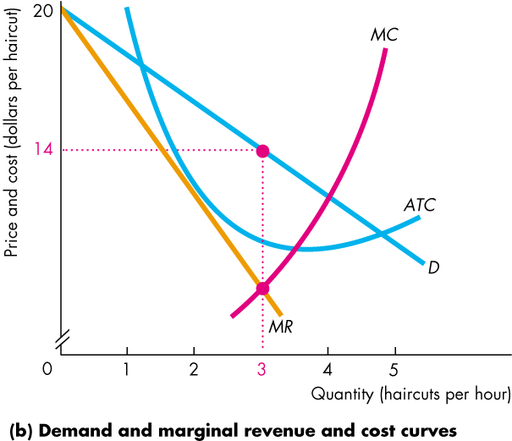
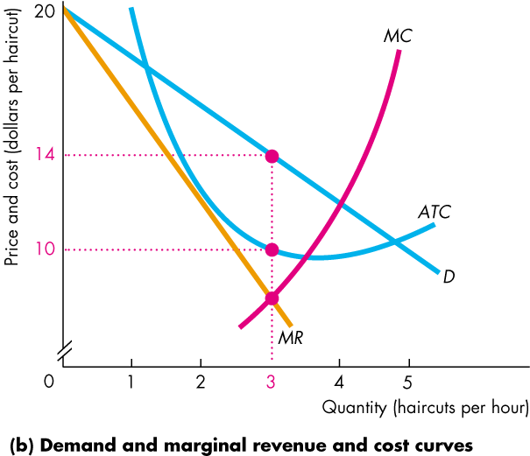
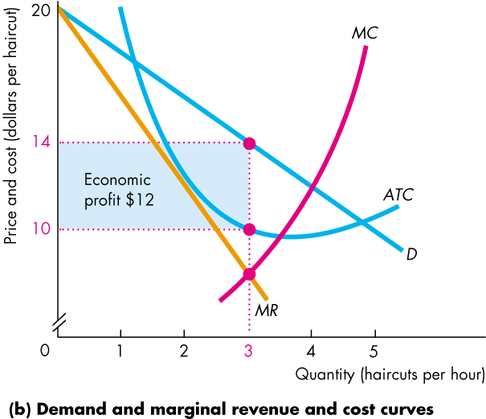
A Single-Price Monopoly’s Output and Price Decision
In part (b), the firm produces the quantity at which MR = MC and sets the price at which it can sell that quantity.
The ATC curve tells us the average total cost.
Economic profit is the profit per unit multiplied by the quantity produced—the blue rectangle.
Notes:
The classic monopoly diagram
The classic monopoly diagram, Figure 13.4(b) provides a good opportunity to tell your students about the contribution of one of the most brilliant economists of the 20th century, Joan Robinson. This diagram first appeared in her book, The Economics of Imperfect Competition, published in 1933 when she was just 30 years old.
You can learn more about Joan Robinson at http://cepa.newschool.edu/het/profiles/robinson.htm (or use the link on the Economics Place Web site).
Women are still not attracted to economics on the scale that they’re attracted to most other disciplines, so the opportunity to talk about an outstanding female economist shouldn’t be lost. Joan Robinson was a formidable debater and reveled in verbal battles, a notable one of which was with Paul Samuelson on one of her visits to MIT. Anxious to make and illustrate a point, Samuelson asked Robinson for the chalk. Monopolizing the chalk and the blackboard, the unyielding Robinson snapped, “Say it in words young man.” Samuelson meekly obeyed. This story illustrates Joan Robinson’s approach to economics: work out the answers to economic problems using the appropriate techniques of math and logic, but then “say it in words.” Don’t be satisfied with formal argument if you don’t understand it. Your students will benefit from this story if you can work it into your class time.

Slide 36
A Single-Price Monopoly’s Output and Price Decision
The monopoly might make an economic profit, even in the long run, because barriers to entry protect the firm from market entry by competitor firms.
But a monopoly that incurs an economic loss might shut down temporarily in the short run or exit the market in the long run.

Slide 37
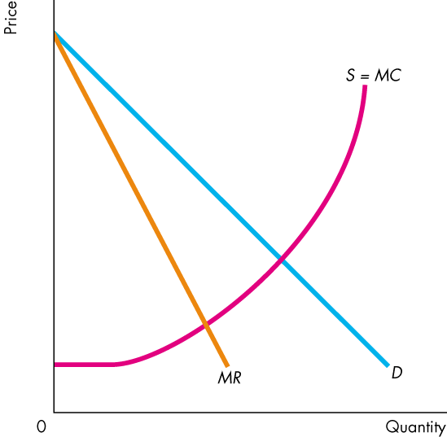
Single-Price Monopoly and Competition Compared
Comparing Price and Output
Figure 13.5 compares the price and quantity in perfect competition and monopoly.
The market demand curve, D, in perfect competition is the demand curve that the firm in monopoly faces.

Slide 38
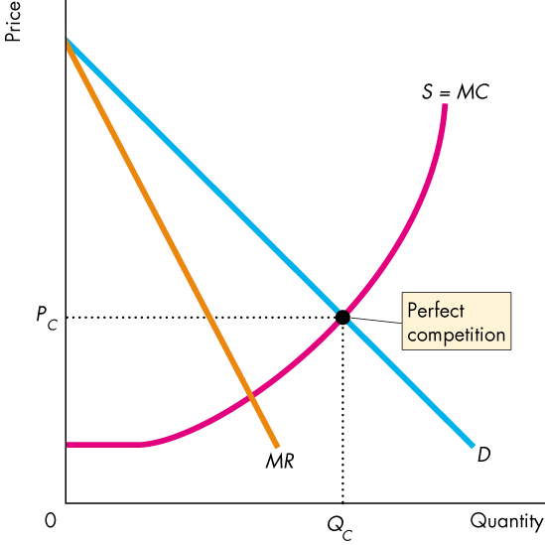
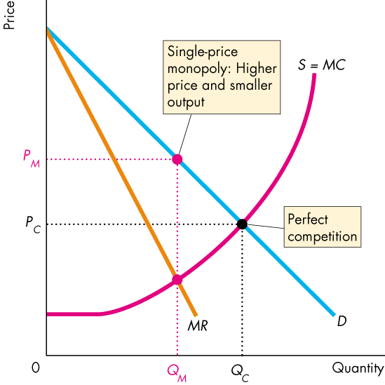

Slide 39
Single-Price Monopoly and Competition Compared
The market supply curve in perfect competition is the horizontal sum of the individual firms’ marginal cost curves, S = MC.
This curve is the monopoly’s marginal cost curve.

Slide 40
Single-Price Monopoly and Competition Compared
Perfect Competition
Equilibrium occurs where the quantity demanded equals the quantity supplied at quantity Q_{C} and price P_{C}.

Slide 41
Single-Price Monopoly and Competition Compared
Monopoly
Equilibrium output, Q_{M}, occurs where marginal revenue equals marginal cost, MR = MC.
Equilibrium price, P_{M}, occurs on the demand curve at the profit-maximizing quantity.

Slide 42
Single-Price Monopoly and Competition Compared
Compared to perfect competition, monopoly produces a smaller output and charges a higher price.

Slide 43
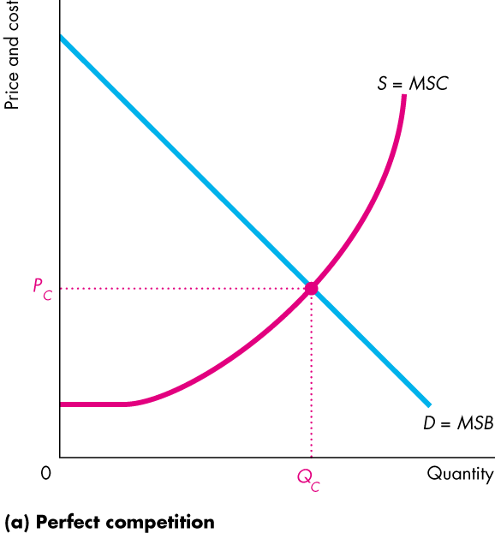
Single-Price Monopoly and Competition Compared
Efficiency Comparison
Figure 13.6(a) shows the efficiency of perfect competition.
The market demand curve is the marginal social benefit curve, MSB.
The market supply curve is the marginal social cost curve, MSC.
So competitive equilibrium is efficient: MSB = MSC.

Slide 44
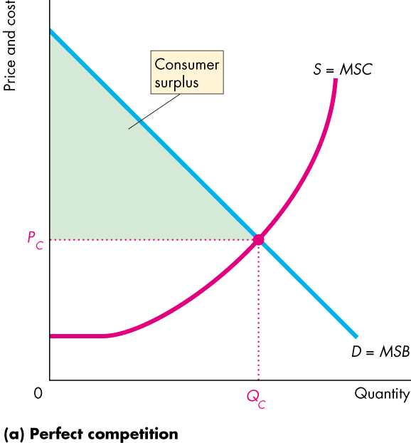
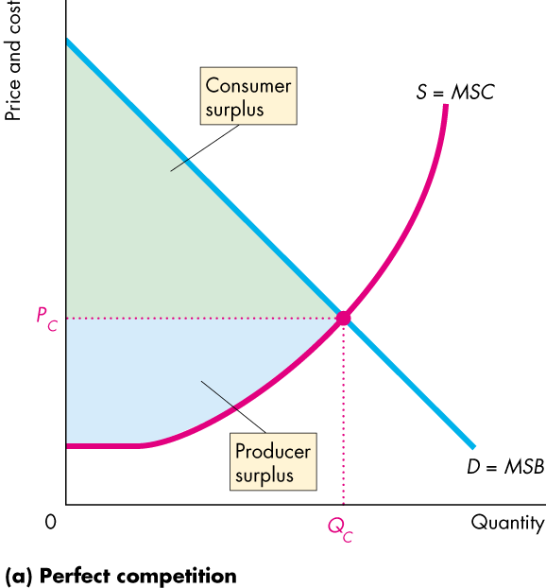
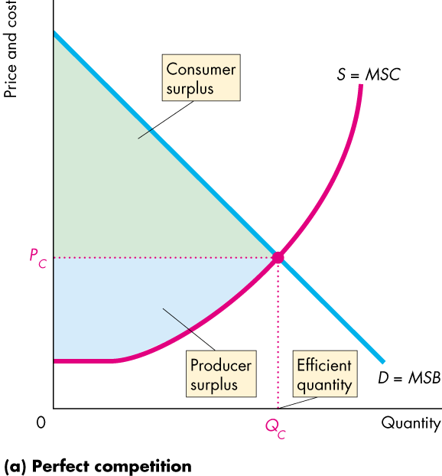

Slide 45
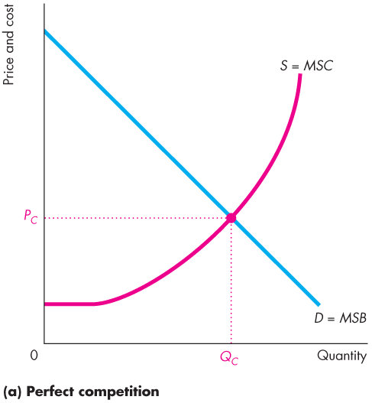
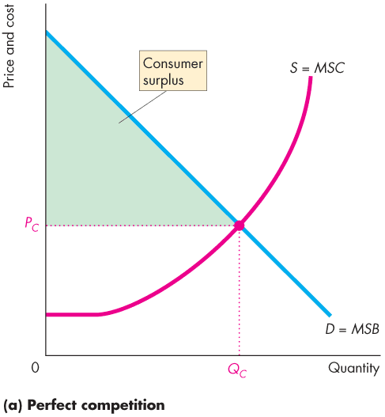
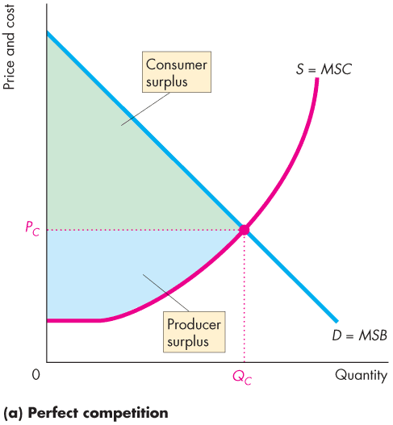
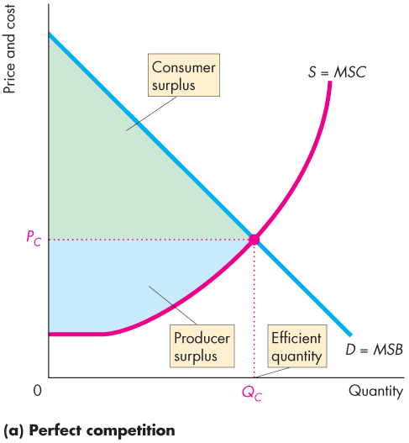
Single-Price Monopoly and Competition Compared
Total surplus, the sum of consumer surplus and producer surplus, is maximized.
The quantity produced in perfect competition is efficient.

Slide 46
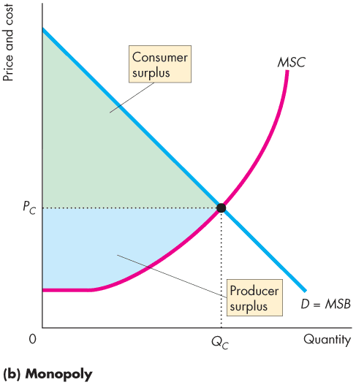
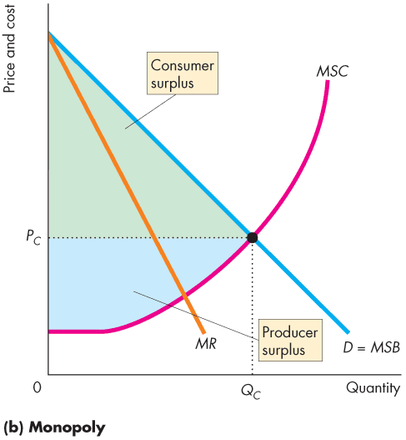
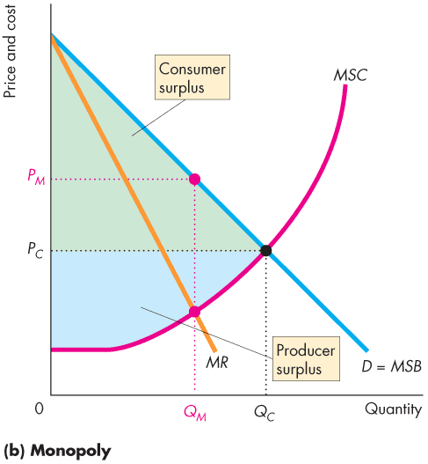
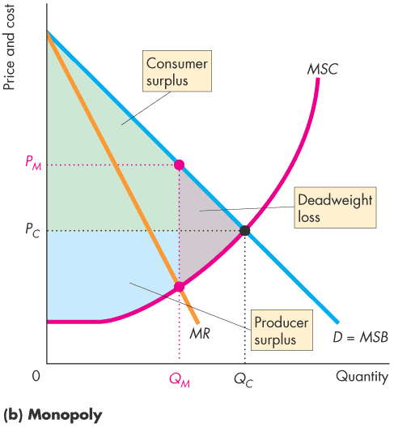
Single-Price Monopoly and Competition Compared
Figure 13.6(b) shows the inefficiency of monopoly.
Because price exceeds marginal social cost, marginal social benefit exceeds marginal social cost, …
and a deadweight loss arises.
Notes:
Monopoly is inefficient. The inefficiency of monopoly is one of the key propositions in this chapter.
Because P > MR, and because MR = MC, P > MC—single-price monopoly under-produces and creates deadweight loss.
Rent seeking uses further resources so potentially the social cost of monopoly is the sum of the deadweight loss and the economic profit that a monopoly might earn.
Adam Smith described the situation thus: “People in the same trade seldom meet together, even for merriment and diversion, but the conversation ends in some contrivance to raise prices.”

Slide 47
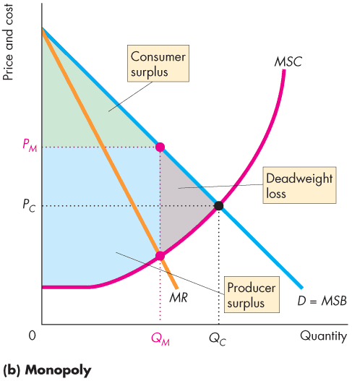

Slide 48
Single-Price Monopoly and Competition Compared
Redistribution of Surpluses
Some of the lost consumer surplus goes to the monopoly as producer surplus.

Slide 49
Single-Price Monopoly and Competition Compared
Rent Seeking
Any surplus—consumer surplus, producer surplus, or economic profit—is called economic rent.
Rent seeking is the pursuit of wealth by capturing economic rent.
Rent seekers pursue their goals in two main ways:
Buy a monopoly—transfers rent to creator of monopoly.
Create a monopoly—uses resources in political activity.

Slide 50
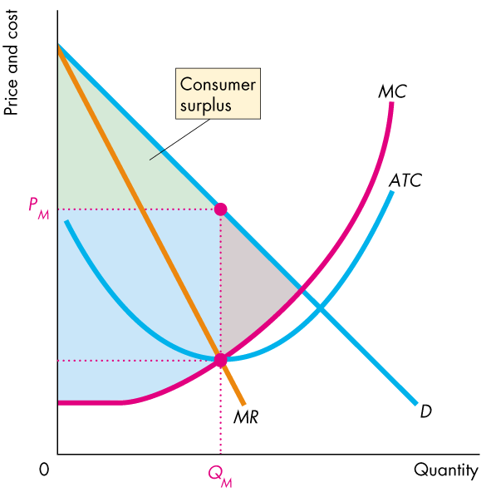
Single-Price Monopoly and Competition Compared
Rent-Seeking Equilibrium
The blue area shows the potential producer surplus with no rent seeking.
The resources used in rent seeking can wipe out the monopoly’s producer surplus.

Slide 51
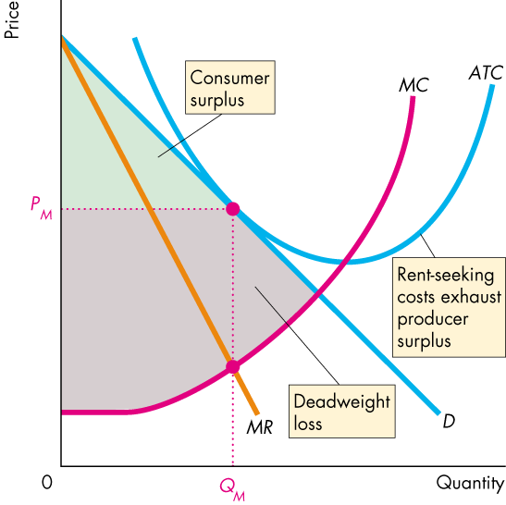



Slide 52


Single-Price Monopoly and Competition Compared
Rent-seeking costs shifts the ATC curve upward,
Producer surplus disappears.
The deadweight loss increases to the larger gray area.

Slide 53
Price Discrimination
Price discrimination is the practice of selling different units of a good or service for different prices.
To be able to price discriminate, a monopoly must:
1. Identify and separate different buyer types.
2. Sell a product that cannot be resold.
Price differences that arise from cost differences are not price discrimination.
Notes:
Price discrimination may not be fair, but it is efficient
Be sure that the students understand that aside from equity considerations, resources will be allocated more efficiently in a monopoly market under any price discrimination scenario than under a single-price scenario.

Slide 54
Price Discrimination
Two Ways of Price Discriminating
A monopoly can discriminate
Among groups of buyers. (Advance purchase and other restrictions on airline tickets are an example.)
Among units of a good. (Quantity discounts are an example. But quantity discounts that reflect lower costs at higher volumes are not price discrimination.)
Notes:
Classroom activity
Check out Economics in Action: Attempting Perfect Price Discrimination

Slide 55
Price Discrimination
Increasing Profit and Producer Surplus
By price discriminating, a monopoly captures consumer surplus and converts it into producer surplus.
More producer surplus means more economic profit. Why?
Economic profit = Total revenue – Total cost
Producer surplus is total revenue minus the area under the marginal cost curve, which is total variable cost.
Producer surplus = Total revenue – Total variable cost
Economic profit = Producer surplus – Total fixed cost

Slide 56


Price Discrimination
A Price-Discriminating Airline
Figure 13.8 shows the market demand and the airline’s marginal cost of $40 a trip.
Single-Price Profit Maximization
The airline sells 8,000 trips a week at $120 a trip.
Travelers enjoy a consumer surplus.

Slide 57


Slide 58
Price Discrimination
The airline has a producer surplus of $640,000.
Can the airline increase its producer surplus by price discriminating?

Slide 59




Price Discrimination
Discriminating Between Two Types of Travelers
In Figure 13.9, part (a) shows the market for business travel.
The airline expands into the leisure market in part (b).

Slide 60








Slide 61
Price Discrimination
Leisure travelers will not pay $120 a trip, so the demand for leisure travel is the curve D_{L}.
The airline sells 4,000 leisure trips at $80 a trip.

Slide 62
Price Discrimination
The airline increases its output to 12,000 trips a week.
Consumer surplus increases and the airline’s producer surplus increases.

Slide 63

Price Discrimination
Perfect Price Discrimination
Perfect price discrimination occurs if a firm is able to sell each unit of output for the highest price someone is willing to pay.
Marginal revenue now equals the price, so …
the demand curve is also the marginal revenue curve.

Slide 64




Slide 65
Price Discrimination
Figure 13.10 shows that the perfect price discriminating monopoly …
increases its output until the price of the last trip equals marginal cost.
Producer surplus is maximized when the lowest fare is $40 and 16,000 trips are bought.
The monopoly makes the maximum possible profit.

Slide 66
Price Discrimination
Efficiency and Rent Seeking with Price Discrimination
The more perfectly a monopoly can price discriminate, the closer its output is to the competitive output (P = MC) and the more efficient is the outcome.
But this outcome differs from the outcome of perfect competition in two ways:
1. The monopoly captures the entire consumer surplus.
2. The increase in economic profit attracts even more rent-seeking activity that leads to inefficiency.
Notes:
Classroom activity
Check out Economics in the News: Microsoft Monopoly

Slide 67
Monopoly Regulation
Regulation: rules administrated by a government agency to influence prices, quantities, entry, and other aspects of economic activity.
Two theories about how regulation works are social interest theory and capture theory.
Social interest theory is that the political and regulatory process relentlessly seeks out inefficiency and regulates to eliminate deadweight loss.
Capture theory is that regulation serves the self-interest of the producer, who captures the regulator and maximizes economic profit.
Notes:
A quick introduction
The treatment of monopoly policy here is brief and designed for the instructor who wants to cover the topic briefly and at this point in the course. Chapter 14 provides a more extensive treatment of regulation and antitrust law. You can cover that chapter, in whole or part, right now if you want to do more on the topic.

Slide 68
Monopoly Regulation
Efficient Regulation of a Natural Monopoly
When demand and cost conditions create natural monopoly, the quantity produced is less than the efficient quantity.
How can government regulate natural monopoly so that it produces the efficient quantity?
Marginal cost pricing rule is a regulation that sets the price equal to the monopoly’s marginal cost.
The quantity demanded at a price equal to marginal cost is the efficient quantity.
Notes:
Classroom activity
Check out Economics in the News: Is Google Misusing Monopoly Power?

Slide 69


Monopoly Regulation
Figure 13.11 illustrates the marginal cost pricing rule.
Unregulated, the natural monopoly maximizes economic profit by producing the quantity at which marginal revenue equals marginal cost …
and charging the highest price at which that quantity will be bought.

Slide 70

Monopoly Regulation
Regulating a natural monopoly in the social interest sets the quantity where MSB = MSC.
The demand curve is the MSB curve.
The marginal cost curve is the MSC curve.
Efficient regulation sets the price equal to marginal cost.

Slide 71


Slide 72
Monopoly Regulation
With marginal cost pricing, the quantity produced is efficient,
but the average cost exceeds price, so the firm incurs an economic loss.
How can the firm cover its costs and at the same time obey the marginal cost pricing rule?

Slide 73
Monopoly Regulation
Where possible, a regulated natural monopoly might be permitted to price discriminate to cover the loss from marginal cost pricing.
Or the natural monopoly might charge a one-time fee to cover its fixed costs and then charge a price equal to marginal cost.

Slide 74
Monopoly Regulation
Second-Best Regulation of a Natural Monopoly
Another alternative is to permit the firm to produce the quantity at which price equals average cost and to set the price equal to average cost—the average cost pricing rule.
Or the government might pay a subsidy equal to the monopoly’s loss.

Slide 75
Monopoly Regulation
Implementing average cost pricing can be a problem because it is not possible for the regulator to be sure what the firm’s costs are.
Regulators use one of two practical rules:
Rate of return regulation
Price cap regulation

Slide 76
Monopoly Regulation
Rate of Return Regulation
Under rate of return regulation, a firm must justify its price by showing that its return on capital doesn’t exceed a specified target rate.
This type of regulation can end up serving the self-interest of the firm rather than the social interest because …
the firm’s managers have an incentive to inflate costs and use more capital than the efficient amount.

Slide 77
Monopoly Regulation
Price Cap Regulation
A price cap regulation is a price ceiling.
The rule specifies the highest price that the firm is permitted to charge.
This type of regulation gives the firm an incentive to operate efficiently and keep costs under control.
Figure 13.12 shows how a price cap works.

Slide 78






Monopoly Regulation
Unregulated, a natural monopoly profit-maximizes.
A price cap sets the maximum price.
The firm has an incentive to minimize cost and produce the quantity on the demand curve at the price cap.
The price cap regulation lowers the price and increases the quantity.

